Slide 1


Sports Analytics for Training, Health, and Safety Module 5
Dr. Dave Schrader
Teaching Module For Teradata University Network
Send Questions or Comments to drdaveschrader@gmail.com

Slide 2
THIS IS MODULE 5
There are two versions of the materials
You can pull the “Overview Deck” which has all the slides in one place
Or – you can access 6 modules that carve the material up
#1 – Sports is Big Business
#2 – Sports Analytics is HOT
#3 – Sports Analytics for Business Operations
#4 – Sports Analytics for Team Operations
#5 – Sports Analytics for Training, Health, and Safety
#6 – How to Get a Job in Sports Analytics

Slide 3
Health and Safety Topic 5
Conditioning is very important
Strength and Fitness Coaches starting to use analytics
Drives equipment improvements
Integration of all factors, e.g., wearables, also sleep data
GOAL: “see” what’s happening day by day in athlete training
Notes:
highlights the general field of strength and fitness, the associated coaching staff, and why this is an important area. One side comment you can make is that students who study this area have an extra advantage in that even if they do not get a job with a sports team, all of the skills they learn are relevant topics for healthcare in general, a booming job field.

Slide 4
Conditioning – Fitness vs. Fatigue/Injury
Strength and Fitness coaches (and team doctors) are key to keeping players healthy
They often have degrees in kinesiology (science of movement)
Weight training is becoming more scientific
Notes:
highlights the general field of strength and fitness, the associated coaching staff, and why this is an important area. One side comment you can make is that students who study this area have an extra advantage in that even if they do not get a job with a sports team, all of the skills they learn are relevant topics for healthcare in general, a booming job field.

Slide 5
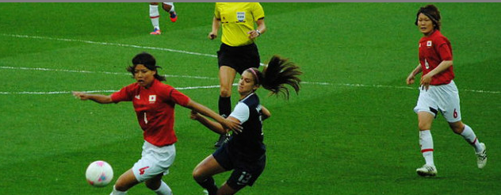
Women’s Soccer
“The Shanghai Women’s Soccer Team taps Zebra’s MotionWorks Sports Solution to track stats enabling management to not only assess how well a player’s performing on the field, but whether she should still be in the game and other criteria.”
Zebra Technologies rep cites 4 advantages:
For broadcasters. Imagine being in front of the TV and knowing the speed of a player while they’re running
For coaching. If a coach calls a certain play and the team member didn’t run it right, feedback is offered – all information determined by a tag affixed to each shoulder of the player
For training and fitness, informing bosses as to how well a player is performing today versus yesterday.
For safety. ‘Let’s say you come off an injury and prior to your injury, you were able to run at this speed and participate in this many plays. You run a practice in this certain way, and you are back but not quite up to speed’.“
Source: http://blog.atlasrfidstore.com/fast-tracking-sports-analytics-rfid
Notes:
A good example from women’s soccer and why Zebra tags are used for health and safety. Generally (because of money) the women’s teams will lag the men’s teams (mostly because of funding) but once the technology and benefits are proven, expect wider use.

Slide 6
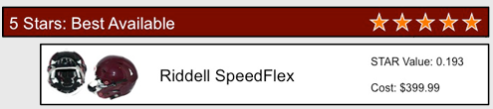
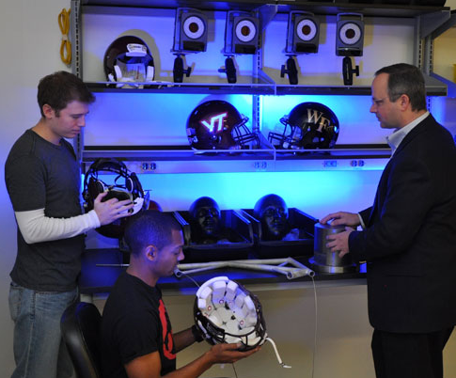
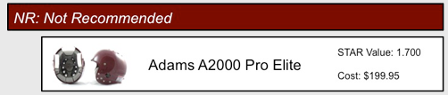
Football Helmets - Protection Ratings Virginia Tech Research (also at Purdue)
Analyzed helmet sensor data on 1.2 million head impacts sustained by more than 1,800 football players on eight collegiate teams, along with the number of diagnosed concussions they suffered, over a six-year period between 2005 and 2010. Researchers identified a 53.9% reduction of concussion risk associated with a newer model of Riddell helmet, the Revolution.
Source: http://www.beam.vt.edu/helmet/index.php
Source: http://www.beam.vt.edu/helmet/index.php
Notes:
Also https://www.eng.vt.edu/news/virginia-tech-announces-football-helmet-ratings-update-five-new-helmets-meet-five-star-mark
Read more: http://www.momsteam.com/health-safety/football-helmets-reduce-concussion-risk-study-says#ixzz3VXqr72JO
ask the students if they have heard about the problems associated with concussions. This is especially a concern in football, rugby, hockey, and soccer. Not all helmets are equal in their protection capabilities. Fortunately, there is research on what helmets work best at Virginia Tech and at Purdue (my alma mater), which appears on these 2 pages. They have labs where they have sensors inside the helmets that register the impacts (and the protection capabilities) so that the people who buy helmets (equipment managers, but also parents for youth leagues) know what they are buying. The slide shows a 5 star “great” helmet, and a “bad” one. Helmet manufacturers also gather a lot of data to improve their products. Virginia Tech has come up with a metric – a Generalized Concussion Index – that is used to rate the probability of getting a concussion from any particular helmet’s use throughout the season. You could easily give the students a homework assignment to go read about concussions and these lab efforts. If the students have math skills, then have them explore the equations and the terms and be ready to discuss. (Ideally, down the road, I will try to get some helmet data from these schools for students to plot and analyze.)

Slide 7
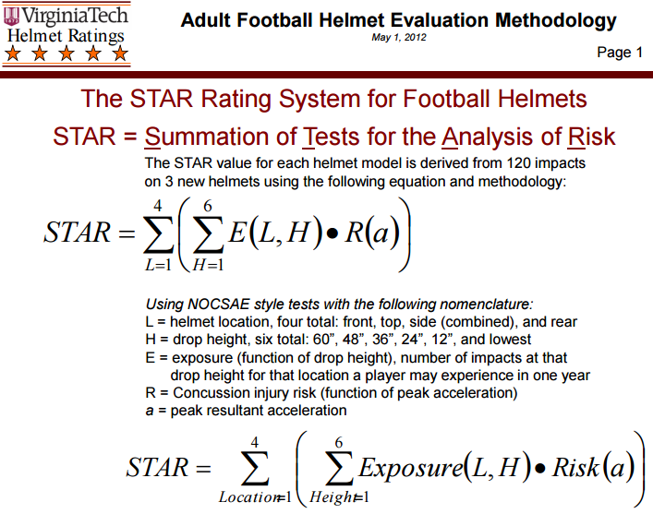
Football (and Hockey) Helmet Research at Virginia Tech
The STAR value represents a Generalized Concussion Incidence In other words, the STAR value is the number of concussions that one player may experience through the duration of playing one complete season with a specific helmet. So, the lower the STAR value, the better the helmet at reducing the risk of concussion, and subsequently the higher ‘# stars’ in the rating system.
Source: http://www.beam.vt.edu/helmet/index.php
Notes:
Now (April 2015) moving from football into hockey helmets – controversial per the manufacturers

Slide 8
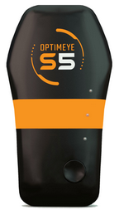
Sports Health – Elite Athletes - Catapult
GPS device – measures acceleration, movement.
“Catapult Sports already has contracts with 250 programs in Australian and European pro soccer, national rowing programs, rugby and Aussie-rules football. Catapult has deals now with 5 NBA teams and 6 in the NFL”
Can start selling its data to broadcasters eager to divulge fun facts such as which NFL linebackers hit the hardest or which NBA scorers have the quickest first step.
Teams will continue to use them in practice and rehab drills and compare the results with biomedical data to get a complete picture of athletic performance
Source: http://www.catapultsports.com/
Notes:
we talked about “wearables” that players can wear that capture data for analysis. Catapult Sports is one of the leaders but not the only company. They are an Australian company that started with Australian Rules Football measurements and have grown rapidly. (There is an MIT video with one of their reps talking in the slides coming up). They focus less on player movement, including player acceleration and health/safety, including biometrics information. A suggestion is to have students explore their website. Another side discussion could be on consumer wearables, e.g., FitBits.

Slide 9
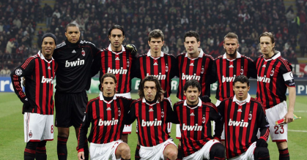
AC Milan - MilanLab
Italian professional soccer team.
The team’s MilanLab, a player health and conditioning research and analytics center, was initiated in 2002. MilanLab has adopted a variety of sports conditioning technologies, including video.
The team tracks 60,000 data points on each player—200 on a single jump alone. Mental, biochemical, and musculo-structural data are gathered every two weeks on eight pieces of scientific equipment. Alerts are created if a player’s data are out of expected range.
Data and analysis gauge the fitness of each player for contract decisions, and are used to predict likelihood of serious injury. AC Milan experienced a 90% reduction in injuries in 2003—the first full use of MilanLab’s establishment
Source: Thomas Davenport, “Analytics in Sports: The New Science of Winning”, International Institute for Analytics White paper, sponsored by SAS, Feb 2014.
Source: http://www.sas.com/content/dam/SAS/en_us/doc/whitepaper2/iia-analytics-in-sports-106993.pdf
Notes:
AC Milan has been a European leader in the use of analytics, as some of the data points on this slide point out.

Slide 10
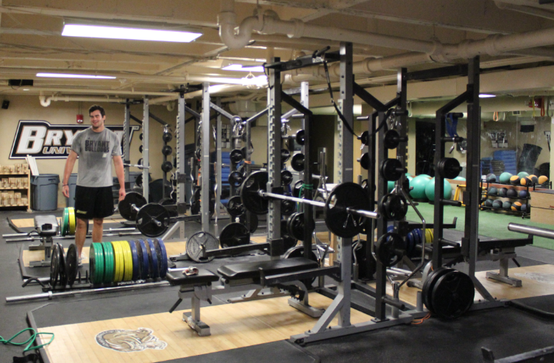
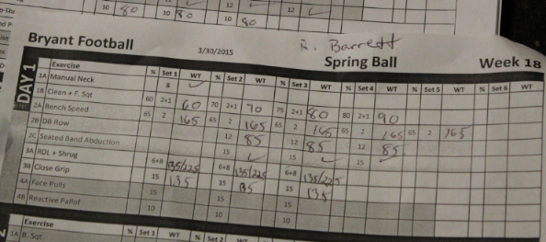
Weight Room Data and Analytics
Traditional approach
Pen and paper
Little analysis
Notes:
many strength and fitness coaches are started to adopt technology in the weight room. This replaces the old paper and pen approach (with a filing cabinet) with tablets at each station so athletes can enter information directly (ultimately the machines will do this for them!). You can have a discussion of why making information collection and analysis easier helps both individuals and coaches (motivation, ability to see trends, see the impact of injuries). P. 87 shows just 2 of the many emerging technologies to capture more information about lifting. You can ask the students how many are wearing personal devices or have tried any of these new systems.

Slide 11
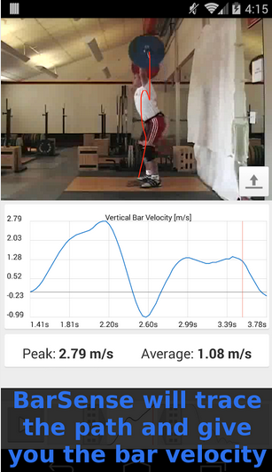
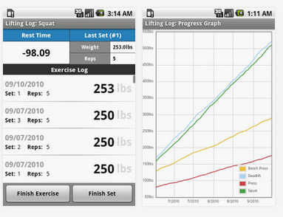
Weight Room – Strength and Fitness
LiftingLog BarSense
Source: https://play.google.com/store/apps/details?id=net.kndy.liftinglog&hl=en and
https://play.google.com/store/apps/details?id=com.barsense.main&hl=en
Notes:
many strength and fitness coaches are started to adopt technology in the weight room. This replaces the old paper and pen approach (with a filing cabinet) with tablets at each station so athletes can enter information directly (ultimately the machines will do this for them!). You can have a discussion of why making information collection and analysis easier helps both individuals and coaches (motivation, ability to see trends, see the impact of injuries). P. 87 shows just 2 of the many emerging technologies to capture more information about lifting. You can ask the students how many are wearing personal devices or have tried any of these new systems.

Slide 12
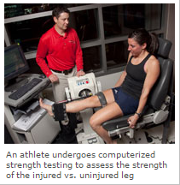
Athlete Rehabilitation
Goal: Restoring strength, range of motion, flexibility and speed, decreasing recovery time
What do football players, soccer players, dancers and runners have in common? Hamstring strains, which are among the most common injuries for all of these athletes.
A 2008 study from the NFL showed that hamstring strains were the second most common injury after "knee sprains." In soccer, hamstring strains can account for up to 23 percent of all acute injuries.
One of the most frustrating aspects of hamstring injuries is the high rate of recurrence. One study showed that 50% of a group of athletes with hamstring injuries re-injured the same hamstring within the first year of return to sport.
A 2010 study from Norway showed that soccer players who previously injured their hamstring were more than twice as likely to suffer another hamstring injury than those athletes who had not sustained a hamstring injury.
Source: http://www.uwhealth.org/physical-therapy-athletic-training/this-month-in-uw-health-sports-rehabilitation-april-may-2010/27379
Notes:
rehab after injuries is an important area, so having data on the player’s “before” state can help with decisions on when to re-activate him (without doing more damage). This has direct analogies to general health (a career area for anyone who learns sports analytics). This page contains some sample data points from a University of Wisconsin web page on sports medicine. They are developing new procedures for treating hamstring injuries, which are common across sports. Data helps understand the frequency of relapses

Slide 13
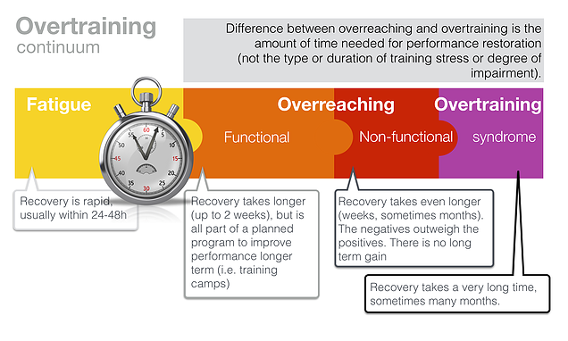
Overtraining Analytics
A new area of focus, using data to answer questions like:
How much and when to train?
When to take days off?
Impact of sleep and nutrition on training?
Source: http://www.mysportscience.com/#!Overtraining-is-it-real/cjds/54f487050cf2458597549940
Notes:
A “hot topic” at the MIT event was on overtraining. A quote earlier in the Module 4 football module by Sean Payton of the New Orleans Saints pointed out that he needs to know from the training staff when to cut back on the intensity of drills during the week, for example. There are many questions in this area that unanswered but a few are listed on this page. You can ask students to come up with more. The diagram comes from the overtraining literature. A good homework assignment would be to go gather more information about a particular sport and do a literature survey on overtraining articles for that particular sport.
Summary: we just touched on a few of the topics of how analytics on athlete conditioning can help the strength and conditioning coaches (and team doctors) track athlete capacities, growth of capabilities over time, as well as recovery time after injuries.

